Slide 1

WELCOME TO
Road/vise.
By: Sied Jeremiah Ibarra

Slide 2
AGENDA
Introduction
Problems
Solution
Project Title
Project Objectives
Target Users
Sitemap
Wireframe
Website Demo

Slide 3
INTRODUCTION
Since the pandemic began, the increasing demand for means of private transportation has doubled.
Since then, there is an observed increase in road fatalities and accidents, as well as the congestion of traffic along the highways and public roads.
This website aims to provide free education in a simplified manner to address any ignorance of traffic rules, road safety, the use of public roads, and the privilege of a private motorized vehicle, and for the betterment of the community.

Slide 4
PRoblems

Slide 5
Problems
Ignorance in the road rules and road usage
Lack of physical and situational awareness
Security of pedestrians
Safety of other motorists
Lack of proper driving etiquette
Drivers with anger management Issues

Slide 6
Solutions

Slide 7
SOlutions
A proper driving refresher course
Demonstration and evaluation of related scenarios
Lack of proper driving etiquette
Mental exercises for self-development and action outcomes evaluation.
Use of the Social Media platforms

Slide 8
Project Title

Slide 9
Project Title:
“Road/vise.”

Slide 10
Objectives

Slide 11
Objectives
A more responsible Motorist.
Improved Defensive Driving Skills and Attitude.
A well-rounded motorist with Exemplary Situational Awareness in times of distress, accidents, and road rage.
A motorist with good morals and set an example for road users.

Slide 12
Target Users

Slide 13
Target Users
Motorcycle Users
Private Vehicle Drivers
Public Utility Vehicle Drivers
Pedestrians (bicycles, e-scoot users, and sikads)
Residents of the Republic of the Philippines

Slide 14
Site map

Slide 15
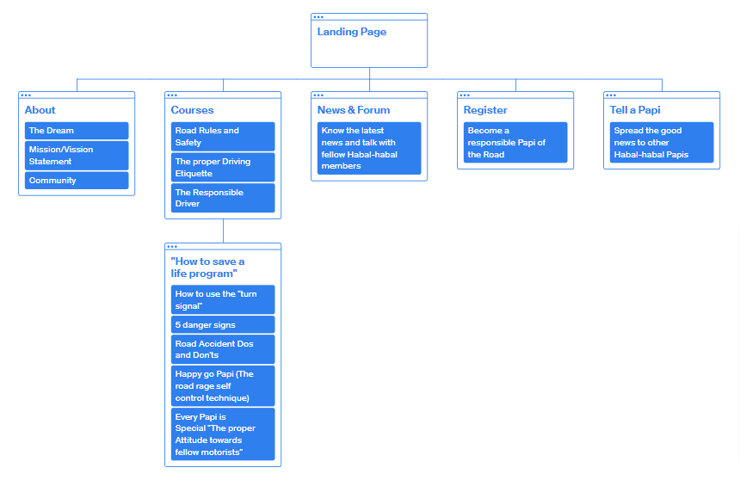
Sitemap

Slide 16
Wireframe

Slide 17
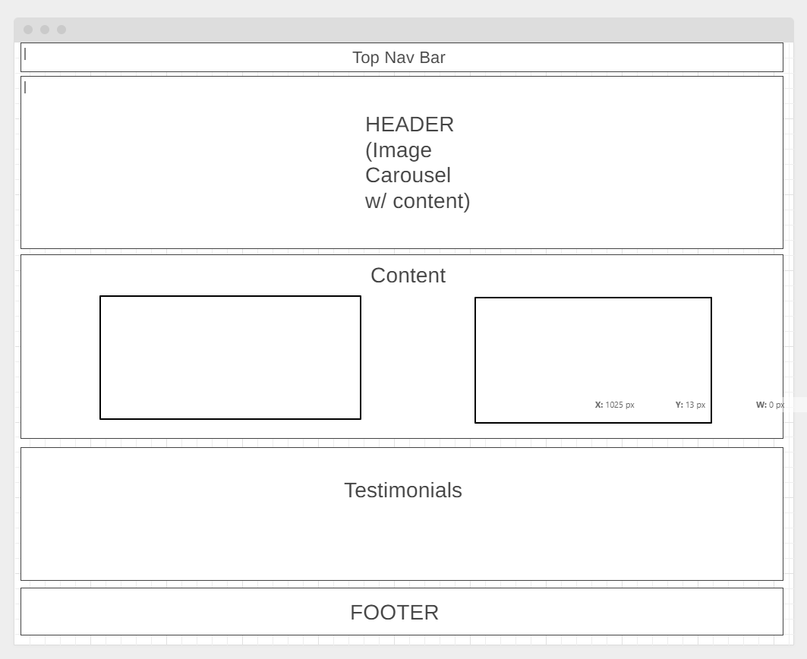
wireframe

Slide 18
Website Demo

Slide 19
WELCOME TO
Road/vise.
By: Sied Jeremiah Ibarra
Live link:
https://siedibarra.github.io/css-sample/

Slide 20
THANK YOU
Sied Jeremiah Ibarra
Siedjeremiahibarra@gmail.com
https://siedibarra.github.io/css-sample/

